Slide 1


P1
Group 6
AI MARKET
Analyzing Public Perception of Deepseek’s Influence on the AI Market
By: Alex Ivanoff, Brynn Butler, Noah Schmidt, Pojanart Foote, and Stephanie Fritz

Slide 2

Introduction &
Objectives

Slide 3


The Big Picture
The AI Market is expanding rapidly, with new players emerging
Deepseek is one of the newest AI companies gaining media attention
Public sentiment influences stock performance and investment decisions
Notes:
I Immediately after the release of DeepSeek the model was noted for its advanced reasoning capabilities and cost-efficiency. It developed for under $6 million which is a fraction of the cost that other existing AI models spent to develop their models. (Google's Gemini cost $19 million to train) Its rapid adoption led to DeepSeek becoming the most downloaded free app on Apple's App Store, surpassing competitors like ChatGPT. The announcement led to a huge sell-off in tech stocks, particularly affecting companies heavily invested in AI infrastructure. Nvidia, a leading AI chipmaker, experienced a 17% drop in its stock price, resulting in a market capitalization loss of nearly $590 billion which was the largest single-day loss for any company on Wall Street. Other tech companies, including Broadcom and Microsoft, also faced significant declines. Investors expressed concerns that DeepSeek's efficient and low-cost AI solutions could disrupt the existing AI market, potentially reducing the demand for high-end chips and extensive data center infrastructures. This development prompted a reevaluation of investment strategies, with some market participants shifting focus from tech giants to other sectors.

Slide 4

Research Goals
Understand public perception of Deepseek’s role in AI
Analyze AI stock trends over the past two years
Determine whether Deepseek’s emergence impacts investor confidence

Slide 5

Research Questions
How have AI stock prices (Google, Microsoft, etc.) performed compared to the Nasdaq Composite Index over the past two years?
What is the overall sentiment (positive, negative, neutral) surrounding Deepseek in news articles, and what themes drive this sentiment?
How has Deepseek’s entrance and technological advancements influenced investor sentiments and AI stock performance?
Notes:
To explore this topic, we structured our analysis around three key research questions:

Slide 6

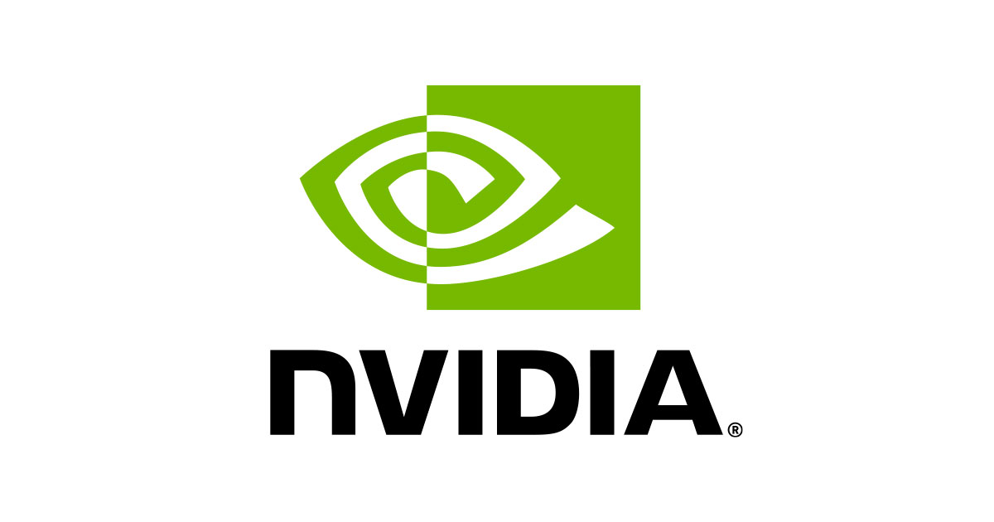


Key Players in the Industry
The AI Powerhouses
Google
NVIDIA
Microsoft
Deepseek
Has been a leader in AI through DeepMind and GoogleAI, powering advancements in search algorithms, natural language processing, and AI-powered tool like Gemini
Is a key player through its partnership with OpenAI, integrating AI into its Azure cloud platform and consumer applications like Copilot and Office 365.
Though newer, is gaining traction with its AI models, and its entrance has raised questions about how it will compete with these establishes giants.
Plays a crucial by providing the hardware backbone for AI with its powerful GPUs, which are essential for AI model training and deep learning.
Notes:
Start: To fully understand Deepseek’s impact, we need to examine the major players in AI that dominate the market. These companies have established themselves as leaders in AI development, infrastructure, and enterprise solutions, all of which shape investor sentiment and stock performance. Let’s explore how each of these companies contributes to the AI ecosystem and how Deepseek fits into this competitive landscape.
Google: Google has long been a leader in AI, leveraging DeepMind and GoogleAI to drive innovations in search algorithms, cloud computing, and natural language processing. Its AI-powered tools, including Gemini, have positioned it as a dominant force in AI software. As a result, Google’s AI developments significantly influence its stock performance and overall market perception.
NVIDIA: Unlike Google and Microsoft, which focus on AI software and cloud integration, NVIDIA provides the hardware foundation for AI. Its GPUs are essential for AI model training, powering everything from machine learning to data centers. As AI adoption grows, NVIDIA’s stock has reflected increased demand for high-performance computing, making it a crucial player in AI infrastructure.
Microsoft: Microsoft is a key AI player through its enterprise-focused AI strategy. By integrating AI into its Azure cloud platform and productivity tools like Office 365, it has positioned itself as a leader in AI adoption for businesses. Microsoft’s continuous AI investments have strengthened investor confidence, making it one of the most resilient AI-driven stocks in the market.
Deepseek: Now, we have Deepseek—an emerging competitor that has quickly gained traction with its AI models. Its entrance has raised questions about how it will challenge these well-established giants and whether it can capture market share. As we saw earlier, its arrival triggered stock fluctuations, highlighting investor uncertainty and competitive pressures in the AI sector.
End: With these major players in mind, let’s take a closer look at how Deepseek’s entry influenced investor sentiment and stock trends.

Slide 7
What’s Different About DeepSeek?
Open source code (anyone can download and analyze how the model is trained)
Significantly lower computer power and cost required to train
Reported around $6M, versus >$100M for ChatGPT’s 4.0 model
The training of ChatGPT’s 3.0 model was estimated to have used enough power to send an electric car to the moon and back over 6 times!
Utilizes a MoE (mixture of experts) method for training
Combination of smaller models trained on subsets of data
Notes:
Immediately after the release of DeepSeek the model was noted for its advanced reasoning capabilities and cost-efficiency. It was developed for under $6 million which is a fraction of the cost that other existing AI models spent to develop their models.
() Its rapid adoption led to DeepSeek becoming the most downloaded free app on Apple's App Store, surpassing competitors like ChatGPT. The announcement led to a huge sell-off in tech stocks, particularly affecting companies heavily invested in AI infrastructure. Nvidia, a leading AI chipmaker, experienced a 17% drop in its stock price, resulting in a market capitalization loss of nearly $590 billion which was the largest single-day loss for any company on Wall Street. Other tech companies, including Broadcom and Microsoft, also faced significant declines.
Investors expressed concerns that DeepSeek's efficient and low-cost AI solutions could disrupt the existing AI market, potentially reducing the demand for high-end chips and extensive data center infrastructures. This development prompted a reevaluation of investment strategies, with some market participants shifting focus from tech giants to other sectors.

Slide 8
Deepseek’s Announcement & AI Stock Reactions
Before (1/10/25)
Immediate Aftermath (1/28/25)
Google (Alphabet Inc.): $192.50
Microsoft: $415.00
NVIDIA: $135.00
Google (Alphabet Inc.): $185.34
(drop of ~1.4%)
Microsoft: $409.75
(drop of ~0.2%)
NVIDIA: $126.75
(drop of ~1.7%)
Announcement (1/27/25)
Currently (2/8/25)
Google (Alphabet Inc.): $188.00
(drop of ~2.3%)
Microsoft: $410.50
(drop of ~1.1%)
NVIDIA: $129.00
(drop of ~4.4%)
Google (Alphabet Inc.): $185.34
(stabilized)
Microsoft: $409.75
(stabilized)
NVIDIA: $129.84
(stabilized)
Notes:
Starter: One of our key research questions was whether Deepseek’s entrance into the AI space impacted investor sentiment and stock performance for major AI companies. To analyze this, we tracked how Google, Microsoft, and NVIDIA’s stock prices moved before, during, and after Deepseek’s announcement.
Before Deepseek’s entrance into the market, AI-related stocks were following their existing growth trends. Google and Microsoft were maintaining steady gains, while NVIDIA was benefiting from rising demand for AI chips. At this point, investor confidence in AI was strong, with little disruption to market momentum.
On January 27, 2025, Deepseek officially announced its AI model, quickly gaining attention for its potential to compete with OpenAI’s ChatGPT, Google Gemini, and Microsoft Copilot. Investors reacted immediately, causing Google and Microsoft’s stocks to dip slightly, while NVIDIA took a more significant hit of 4.4%. This suggests concerns that Deepseek’s AI technology might shift demand away from existing AI models and influence market dynamics.
In the immediate aftermath, stock prices continued adjusting. Google saw another decline of 1.4%, while Microsoft remained relatively stable with a minor dip of 0.2%. Meanwhile, NVIDIA dropped an additional 1.7%, reflecting ongoing uncertainty about AI hardware demand. This shows that while Deepseek’s launch created volatility, its impact varied across different sectors—software companies like Microsoft were more insulated compared to hardware-focused NVIDIA.
Fast forward to today, and we see that stock prices have stabilized. Google remains slightly below its pre-announcement level, Microsoft has recovered, and NVIDIA is showing signs of bouncing back. This suggests that while Deepseek’s announcement caused short-term market reactions, the broader AI sector has adapted to the increased competition.
End: This timeline shows that Deepseek’s entry created short-term market fluctuations for some AI companies, but long-term effects remain uncertain. While stock movements give us insight into investor behavior, another critical factor in understanding Deepseek’s market influence is public sentiment. Next, let’s look at how we gathered and analyzed data for sentiment and stock trends.

Slide 9
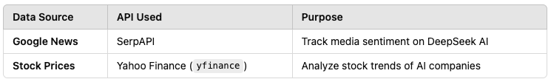
Data Collection & Sources
Data Cleaning:
Removes duplicates, null values, and invalid records.
Standardizes text data for sentiment analysis.
Merging Datasets
Data Sources:
Key Financial Metrics:
Closing Price & Adjusted Close
Stock Trading Volume
Market Volatility Before & After Major DeepSeek Events
Key Financial Metrics:
Closing Price & Adjusted Close
Stock Trading Volume
Market Volatility Before & After Major DeepSeek Events
Notes:
Our goal was to analyze how Deepseek’s entrance into the AI industry has shaped public perception and investor sentiment. To do this, we examined stock price trends, and performed the sentiment analysis of news articles,

Slide 10

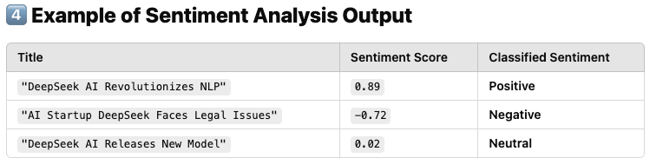
Analysis Approach
Sentiment Analysis: The sentiment analysis in the code was performed using VADER (Valence Aware Dictionary and sEntiment Reasoner), a sentiment analysis tool specifically designed for text data, particularly social media, news articles, and short-form content.
What This Does:
This loads VADER, a pre-trained model that analyzes text sentiment. VADER works without requiring labeled training data, making it ideal for real-time sentiment analysis.
Notes:
Our analysis approach was to analyze the sentiment market had towards DeepSeek during its debut. For Sentiment analysis we used VADER sentiment analyzer , it reads an article or a text and assigns one of three sentiment scores: Positive, Negative, Neutral.
It does not analyze each sentence in the artics individually. Instead, it applies VADER sentiment analysis to the entire news page (or text snippet) as a single unit and then assigns a sentiment score.

Slide 11
Data Visualizations
&
Key Insights

Slide 12
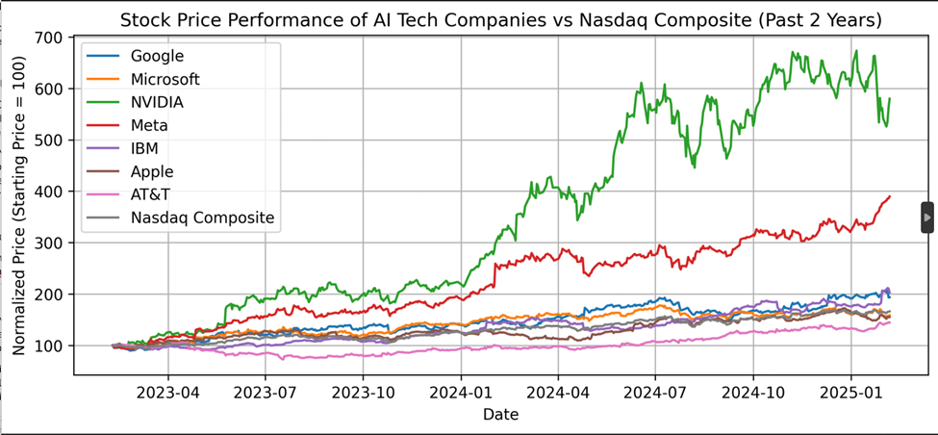
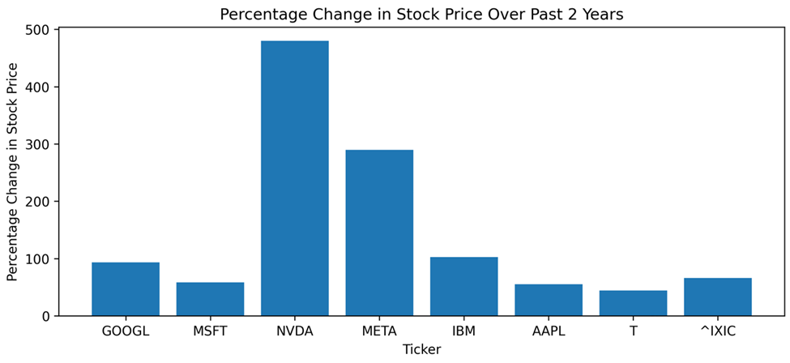
Stock Market Performance
Line chart and Bar graph comparing AI tech stocks to Nasdaq over the past two years
NVIDIA's Dominance: NVIDIA's stock growth significantly exceeded all other analyzed AI companies and the Nasdaq, reflecting its dominance in the AI chip market.
Mixed AI Sector Performance: Other AI companies showed varied growth, highlighting the complex dynamics and diverse influences beyond core AI.

Slide 13
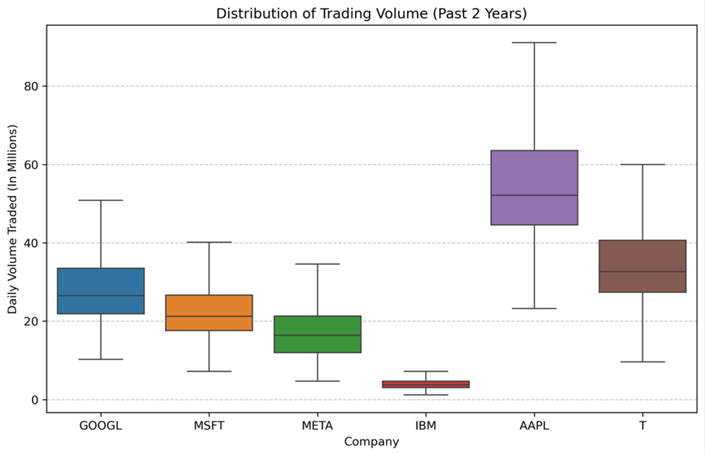
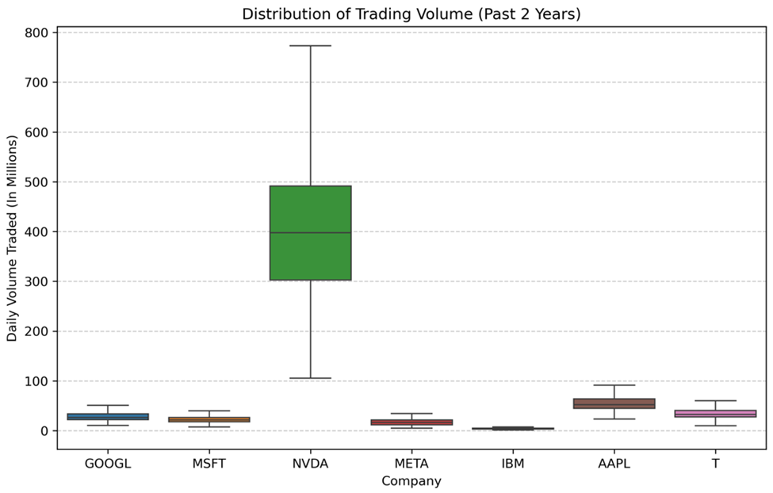
Market Analysis - Trading Volume
Varied Trading Volume: AAPL and T showed the highest median trading volume, indicating strong market interest. GOOGL and MSFT had moderate volume, while META and IBM had lower volumes.
Differing Volatility: Trading volume variability also differed, with AAPL and T showing moderate fluctuations, GOOGL and MSFT slightly higher, and META and IBM exhibiting low variability
NVIDIA's High Trading Volume: NVIDIA's trading volume significantly exceeded all other companies, reflecting its dominant role in the AI chip market and strong investor interest.
NVDA Market Sensitivity: NVIDIA's high and variable trading volume suggests a strong market responsiveness and potential stock price volatility, influenced by news and AI chip market trends.

Slide 14
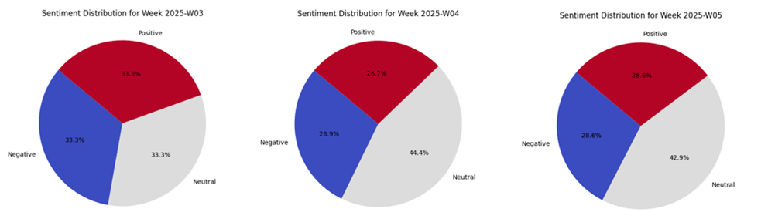
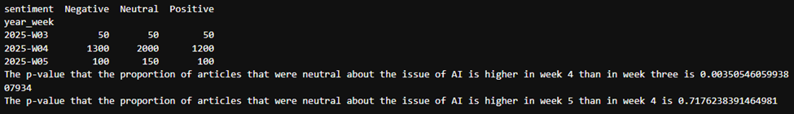
Sentiment Analysis
Pie chart showing Deepseek-related sentiment distribution

Slide 15
Sentiment analysis conclusions
There was a p-value <.05 for there being a smaller proportion of neutral news articles in week 3 than in week 4.
We think that as more information came out, there was a more complicated set of pros and cons to weigh and a more nuanced view of all of the effects, which lead to an increase neutral sentiment.
There was not a statistically significant increase in neutral sentiment from week four to week five.
We think that by that point, people had had enough time and information to arrive at some sort conclusion about whether DeepSeek was a net positive, negative, or neutral, so sentiment remained stable.

Slide 16
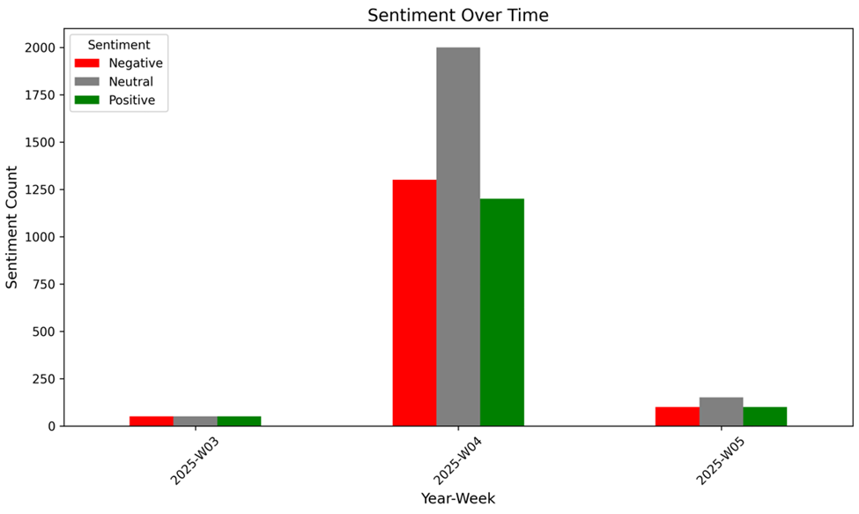
Sentiment Over Time
Bar graph tracking how public sentiment has changed over the past 3 weeks

Slide 17
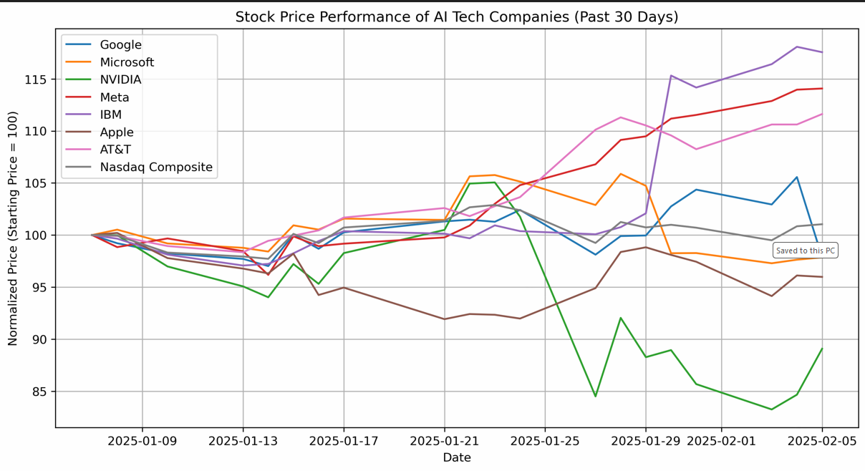
Deepseek’s Impact on AI Stocks
NVIDIA suffered the greatest drop (15% decrease)
Other companies relatively unaffected
AT&T largest growth
Positive earnings report / Company announced they were “doubling down on AI Investments”

Slide 18
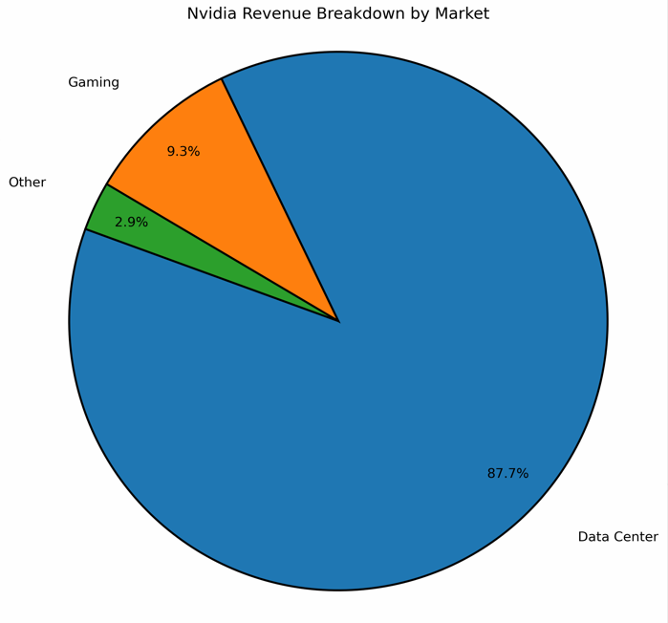
What caused NVIDIA to drop?
From a recent earnings report, 87.7% of revenue was in the Data Center market
DeepSeek release could signal a decrease in reliance on NVIDIA computer parts in training AI models
Recent stock price was likely inflated due to investor confidence in the role NVIDIA would play in AI development

Slide 19
Key Findings
&
Conclusion

Slide 20

Major Takeaways
Chinese background of DeepSeek has created uncertainty in gov. regulation
Many government employees are already banned
Sentiment analysis shows most articles taking a neutral stance
Tech companies remained relatively unaffected
Only large disruption seen in NVIDIA
Selected tech companies kept pace with NASDAQ index
NVIDIA and Meta stocks were most volatile, although trending upward
4 of the 7 stocks outgained the index

Slide 21

Challenges & Limitations
Public Sentiment Analysis
Effect on Stock Prices
News articles do not necessarily perfectly reflect public sentiment.
We only used Google to find articles, so we only had access to what Google gave us.
It has only been a few weeks since DeepSeek was released, so the full effects are probably yet to be seen.
There are many factors that contribute to stock prices, so causation can be difficult to tease out.

Slide 22

Thank you!
Any Questions?

Slide 23




Resource
Page
Google. (n.d.). *Google Search*. Retrieved from https://www.google.com/
Statsmodels: https://www.statsmodels.org/stable/api.html
SerpAPI. (n.d.). *Google News Search API*. Retrieved from [SerpAPI URL - e.g., https://serpapi.com/google-news-api]
Yahoo Finance. (n.d.). *Historical Stock Data*. Retrieved from [Yahoo Finance URL - e.g., https://finance.yahoo.com/]
How to Use yfinance API with Python : https://www.geeksforgeeks.org/how-to-use-yfinance-api-with-python/
How to write a good README for your GitHub project? [https://bulldogjob.com/readme/how-to-write-a-good-readme-for-your-github-project]

